Slide 1

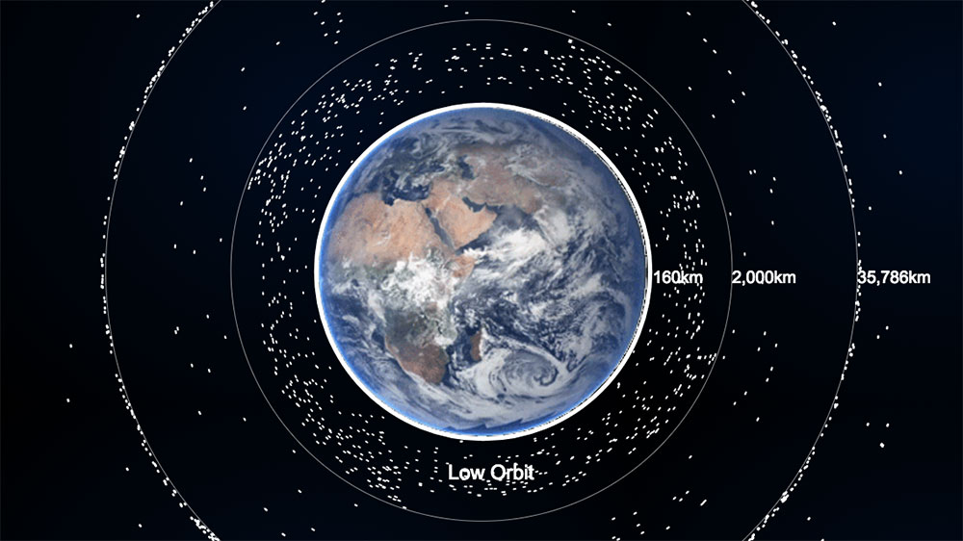
SPCE 5065 MICRO-METEROIDS AND SPACE JUNK
Part 1: Space Junk
Part 2: Micrometeroids

Slide 2
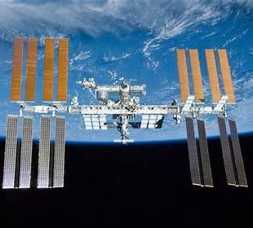

Trent Douglas
HW PROBLEM 1
Write:
Summarize the presentation
2) Describe something you learned from it
3) Write one question you have left about the presentation

Slide 3
Ron Smetek
HW 1
Write:
Summarize the presentation
2) Describe something you learned from it
3) Write one question you have left about the presentation

Slide 4
Claire Wadman
HW #1
Write:
Summarize the presentation
2) Describe something you learned from it
3) Write one question you have left about the presentation

Slide 5
introduction
ORBITAL DEBRIS

Slide 6
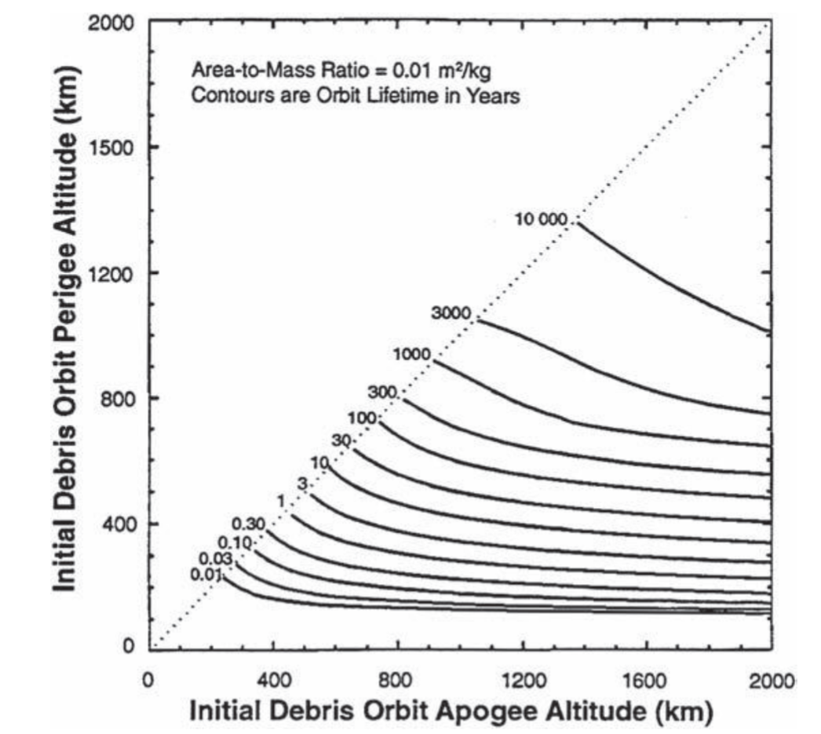
Orbital lifetimes

Slide 7
WHY LARGER OBJECTS TAKE LONGER TO DEORBIT

Slide 8
EXAMPLE
SMALL aluminum CUBE 1 CM³ LARGE aluminum CUBE 10 CM³

Slide 9
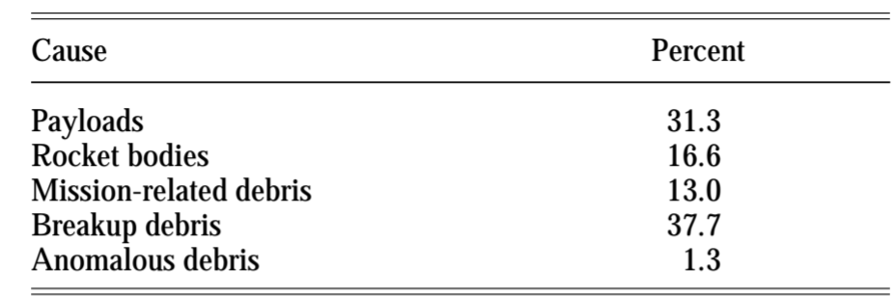
Catalogs of orbit debris

Slide 10
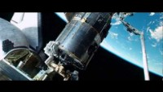

Slide 11
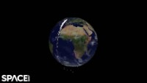
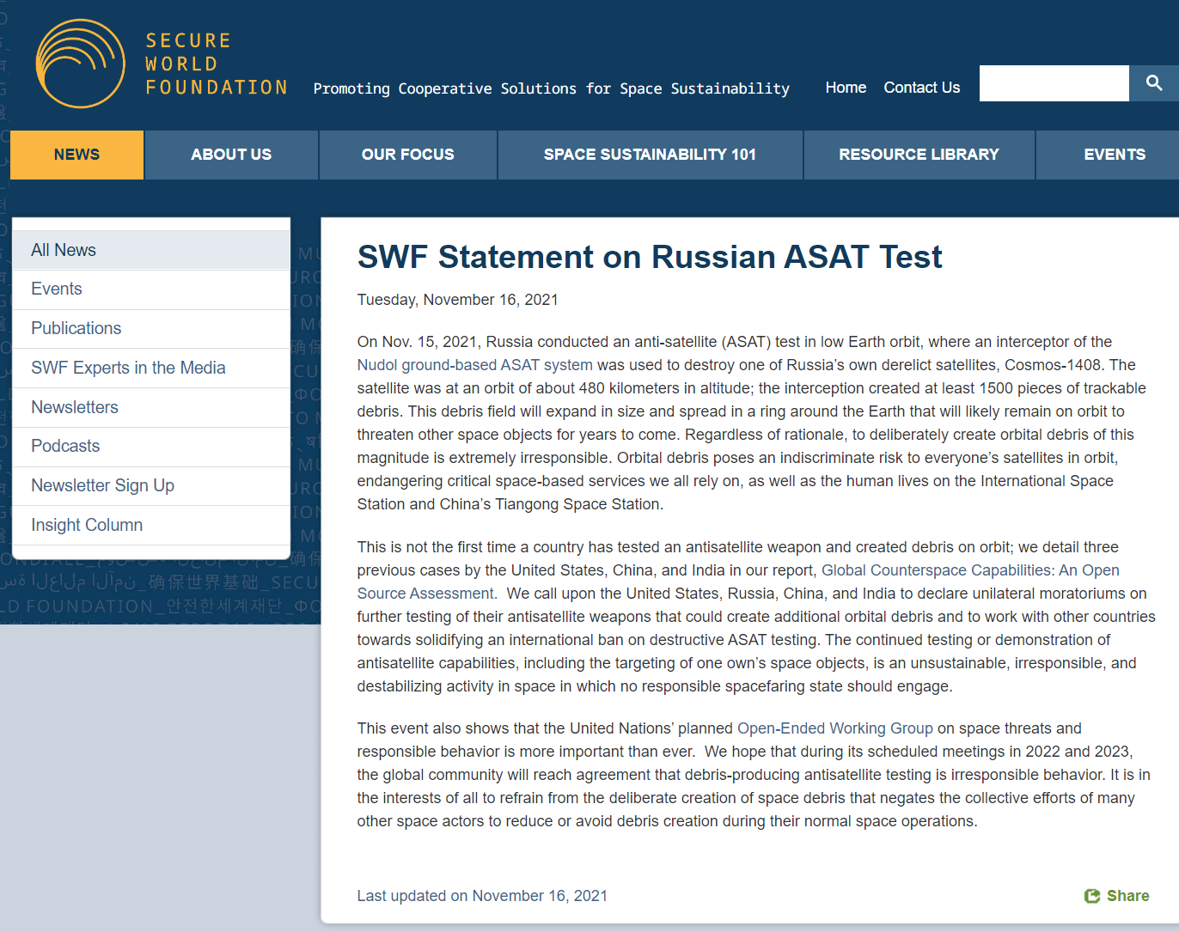
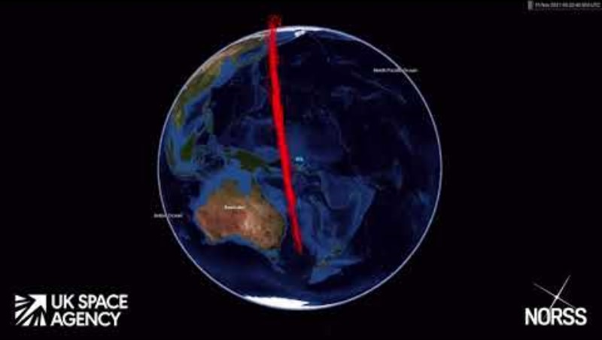

Slide 12
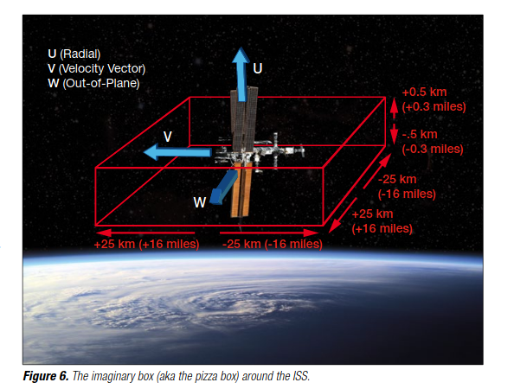
ISS PIZZA BOX

Slide 13
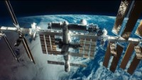

Slide 14
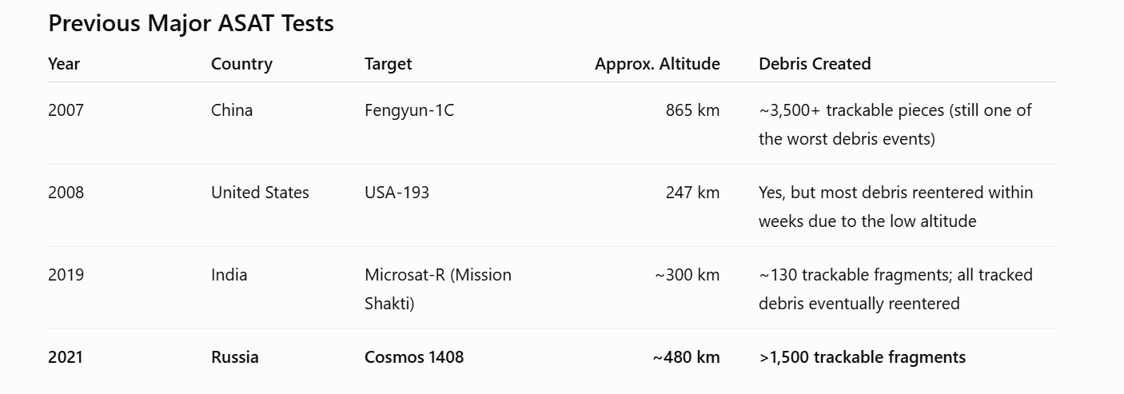
PREVIOUS MAJOR ASAT TESTS

Slide 15
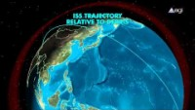
Chinese asat

Slide 16
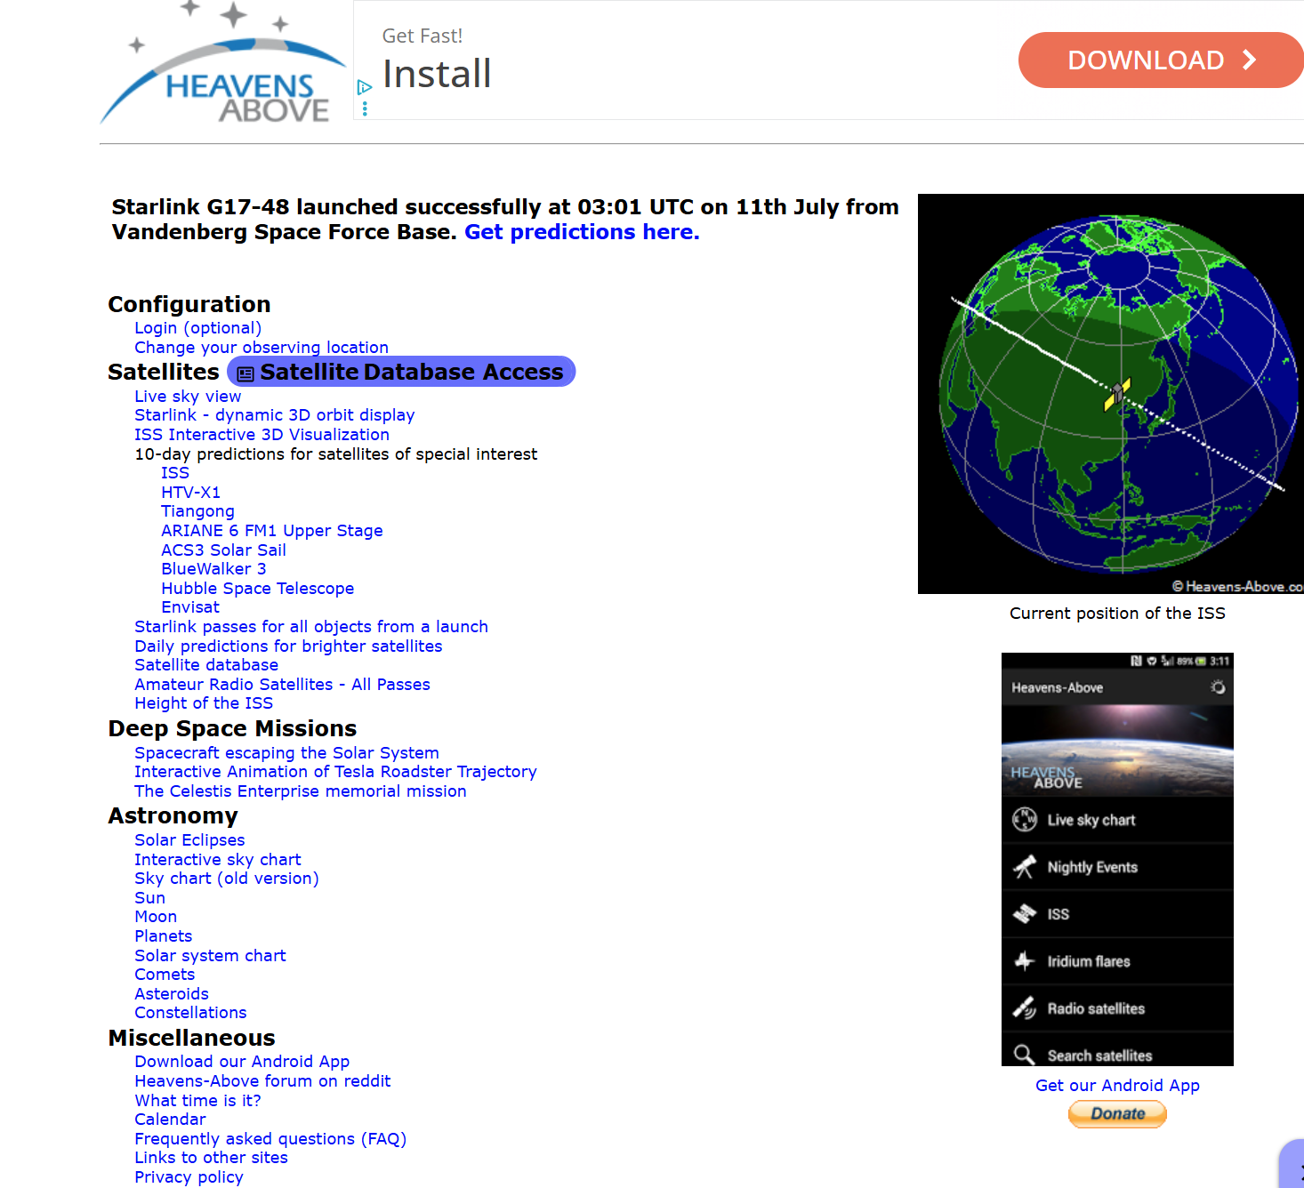

Slide 17
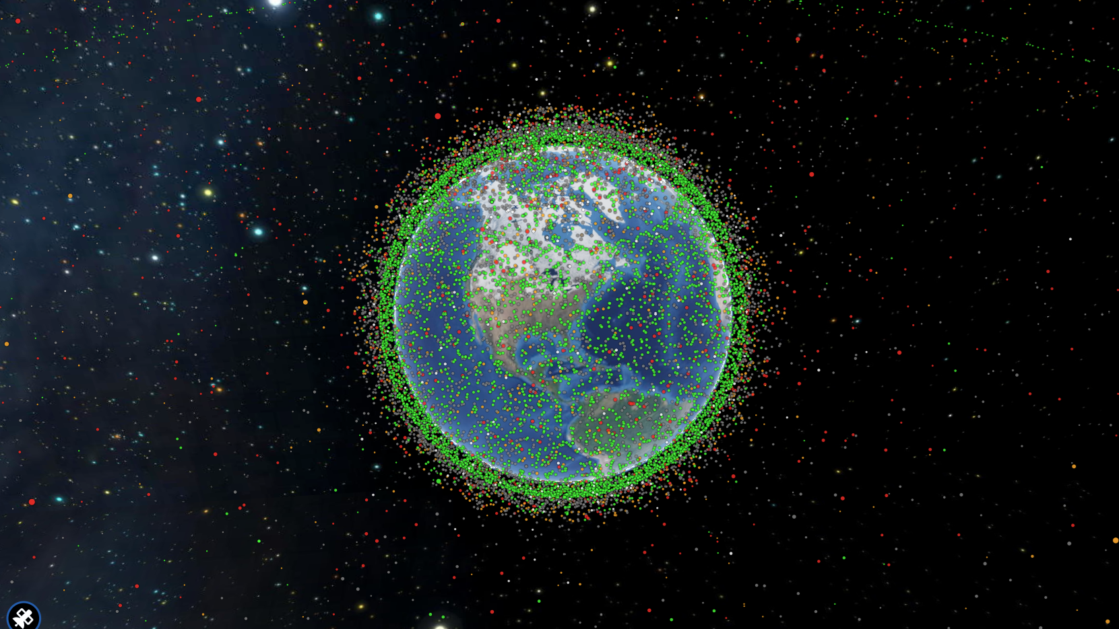

Slide 18
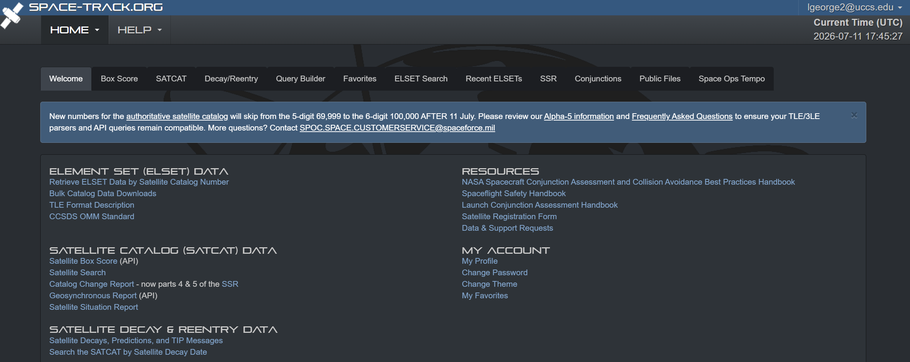

Slide 19
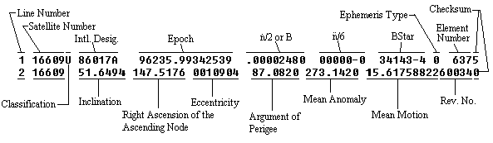
TLE DECODER

Slide 20
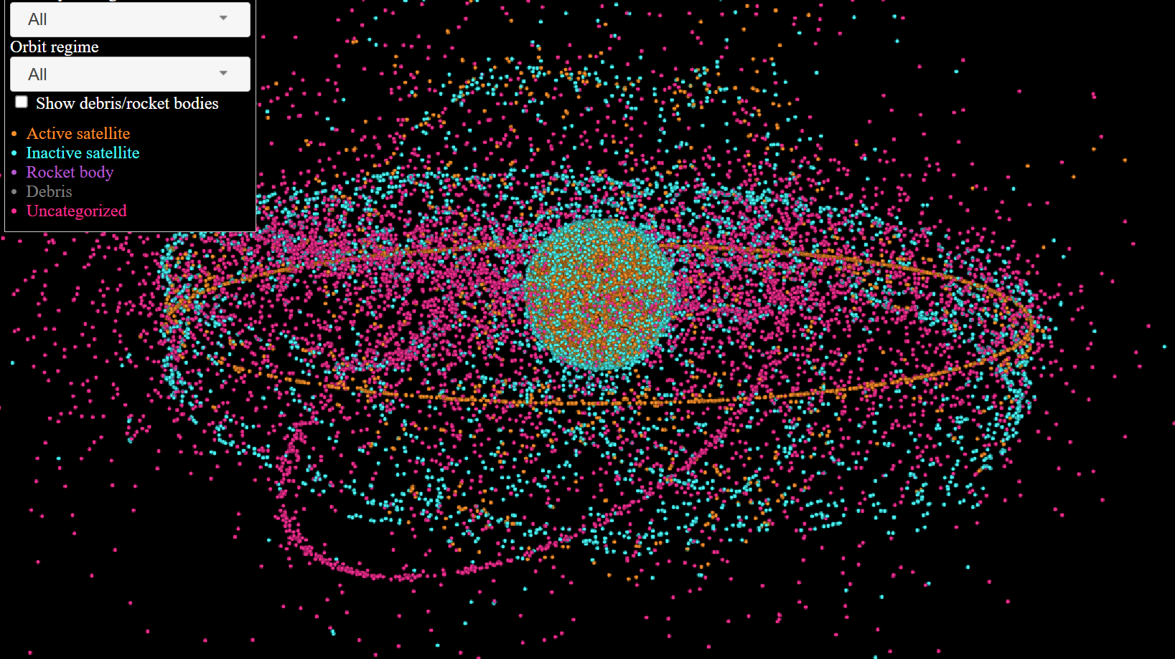

Slide 21
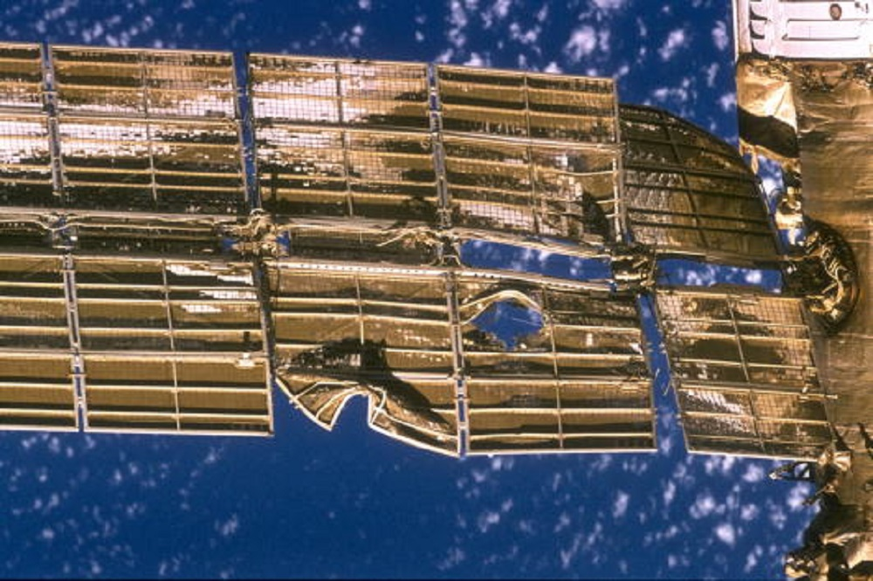
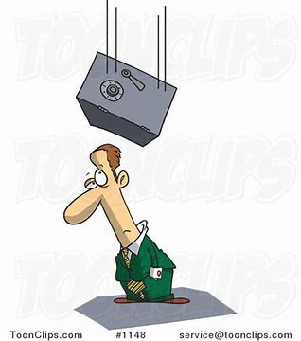
DAMAGE DUE TO PARTICLES
Size of Particle | Effect
.1 mm | Surface erosion
1 mm | Serious damage
3 mm | KE of bowling ball at 100 mph
1 cm | KE of 180 kg safe at 100 mph

Slide 22
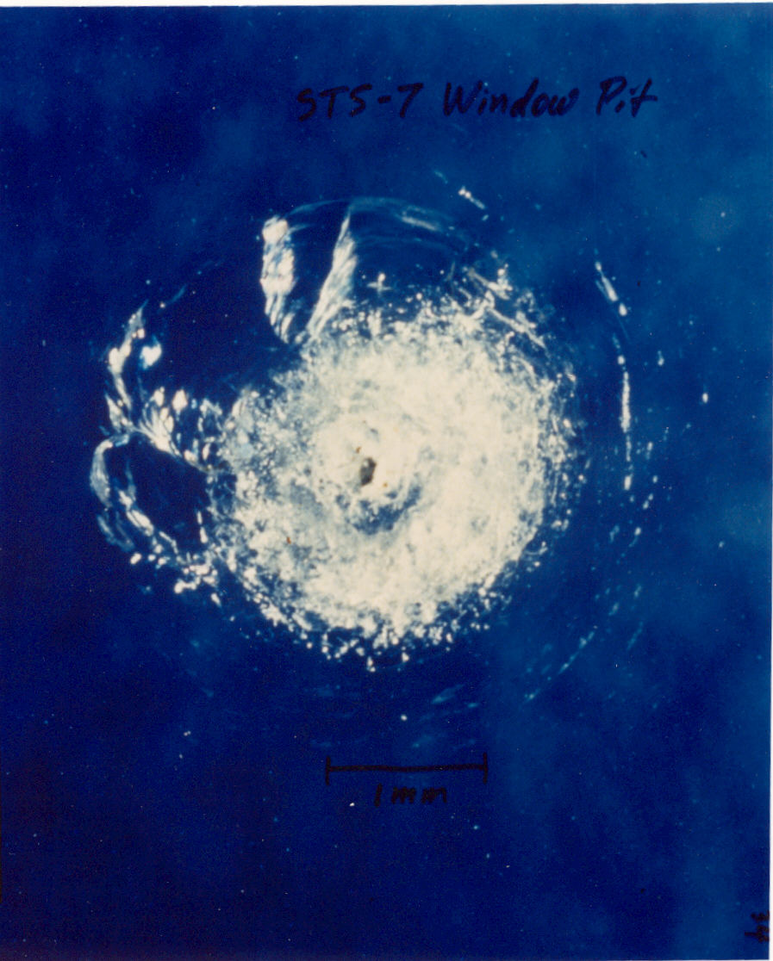
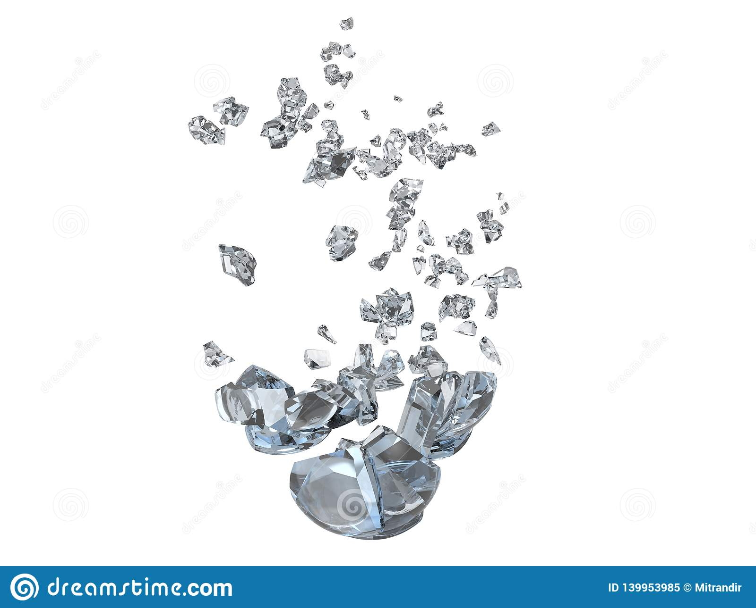
DAMAGE DUE TO PARTICLES
Velocity of Particle | Effect
< 2 km/s | Remains intact
2 – 7 km/s | Shatter into fragments
7 – 11 km/s | Molten state
> 11 km/s | vaporize

Slide 23
HOMEWORK PROBLEM 2
2. Kinetic energies of space objects can be very large. Clearly state your assumptions for this problem.
a. Plot the kinetic energy (in Joules) versus diameter of a particle on a log-log scale. Assume the particle is at the same altitude as the ISS.
b. How does this compare to the Kinetic energy of a small (5 kg), medium (50 kg) and large satellite (100 kg) in the same orbit?
c. What type of satellites are most susceptible to damage due to impacts with man-made space objects?

Slide 24
HOMEWORK PROBLEM 3
3. A 1.0-g piece of space debris strikes a spacecraft in low Earth orbit. Its kinetic energy is said to be equivalent to the gravitational potential energy lost by a 2.0-kg bowling ball dropped from a height of 100 m near Earth’s surface
a. Calculate the impact speed of the debris. Clearly identify all assumptions.
b. Micrometeoroids can encounter spacecraft at much greater relative speeds. Calculate the kinetic energy of the same 1.0-g particle if its impact speed were 20 km/s. Express the result in joules and as an equivalent height from which the 2.0-kg bowling ball would need to fall.
c. How does this compare to the kinetic energy of the space debris?
d. Which poses the greater threat? Be sure to consider the likelihood of impact (although you don’t need to quantify it).

Slide 25
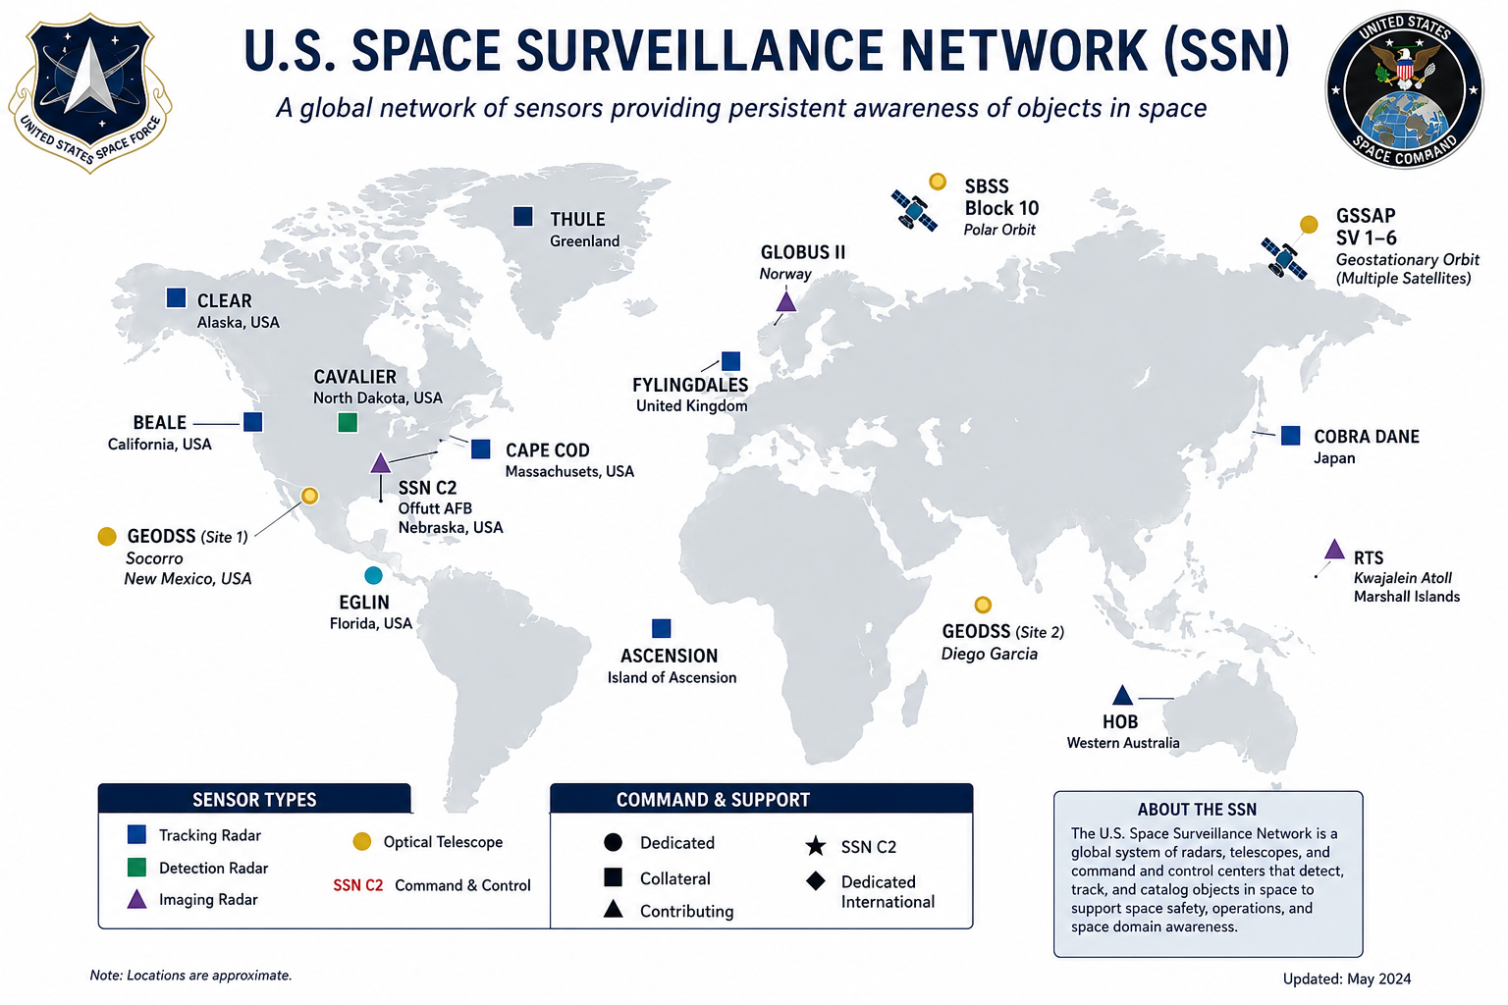

Slide 26
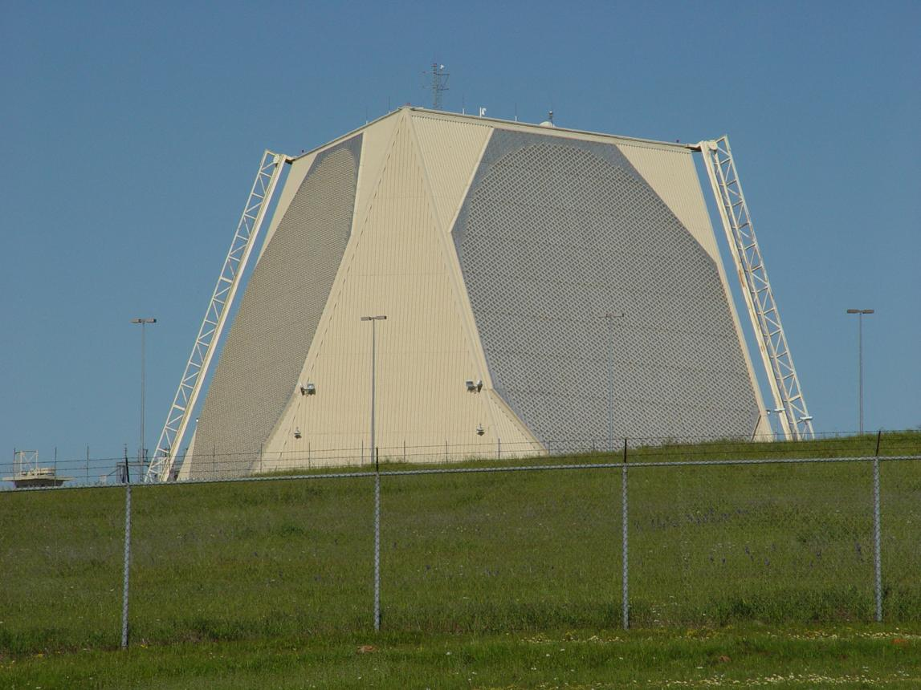
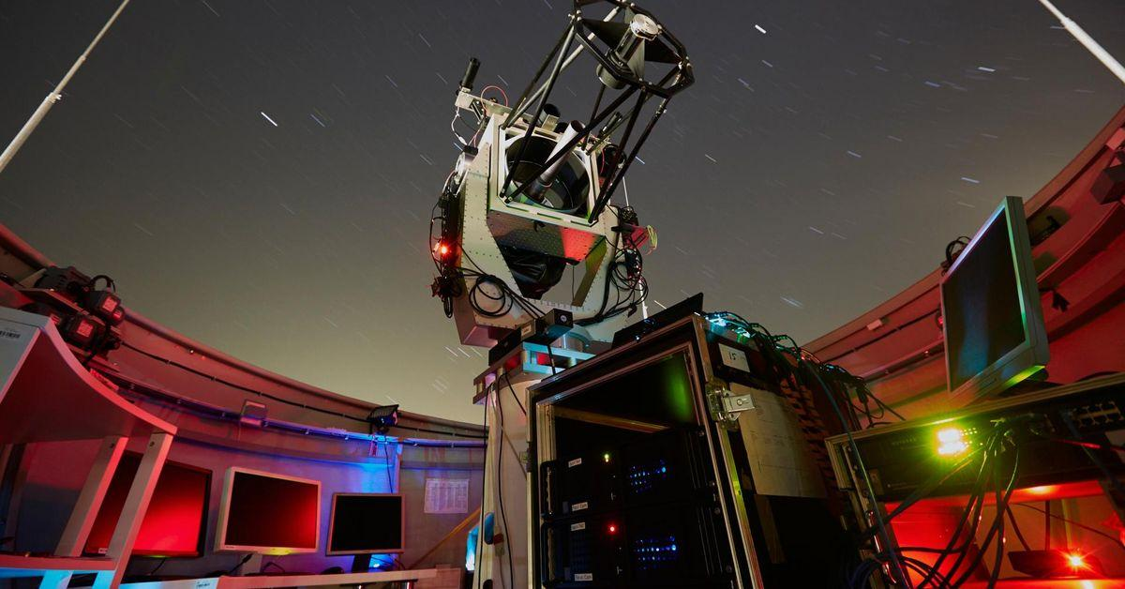
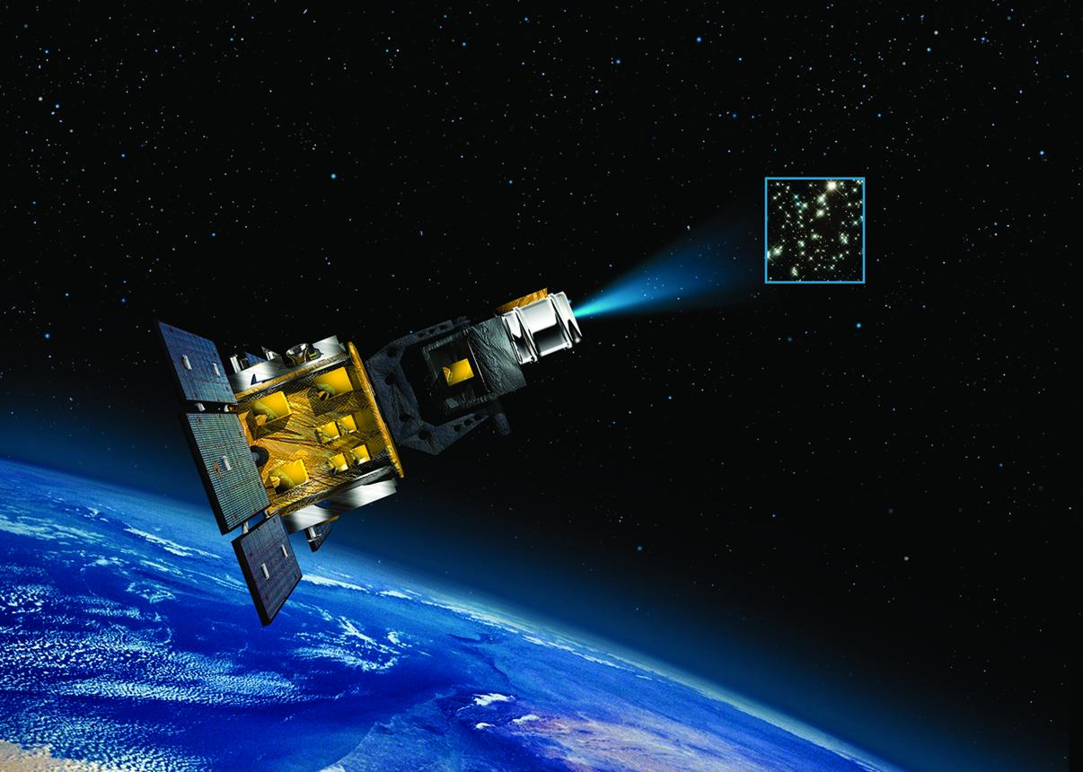
HOw is debris tracked?

Slide 27
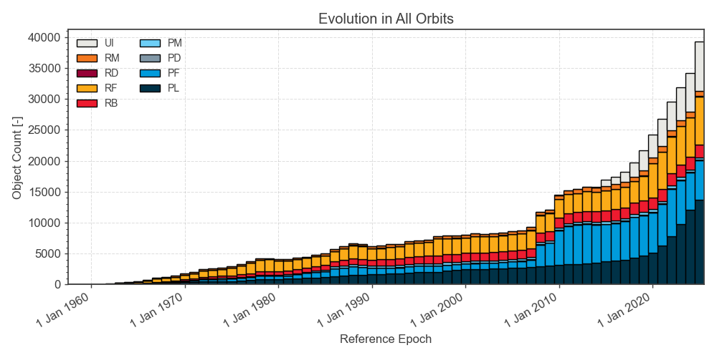

Slide 28
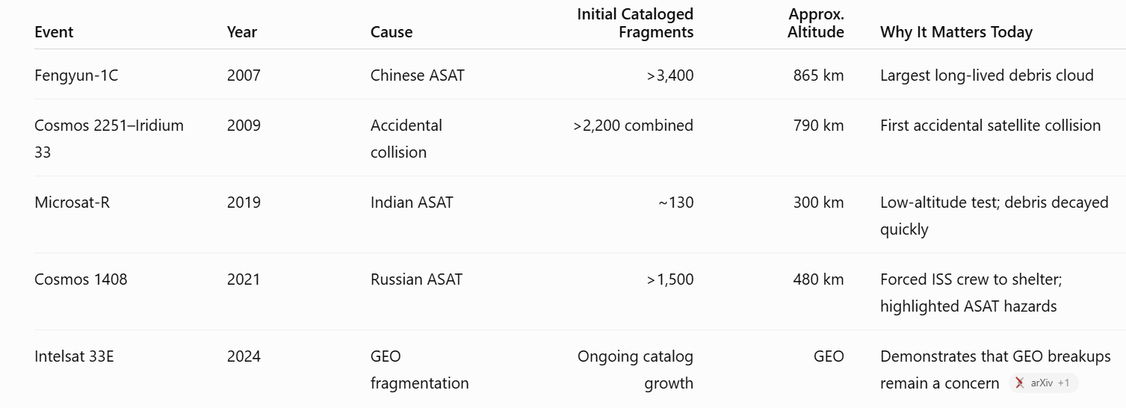
TOP 5 SPACE DEBRIS CONTRIBUTORS

Slide 29
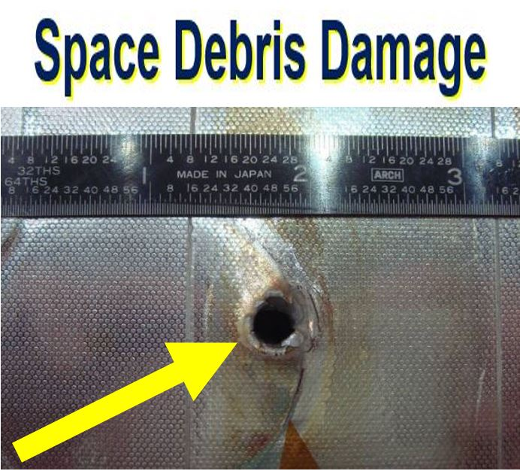
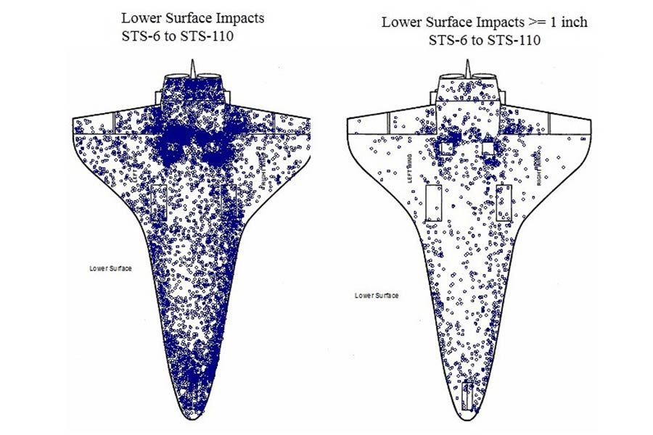

Slide 30
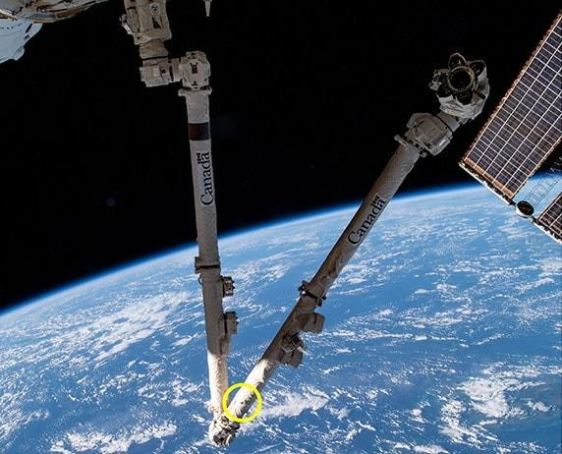
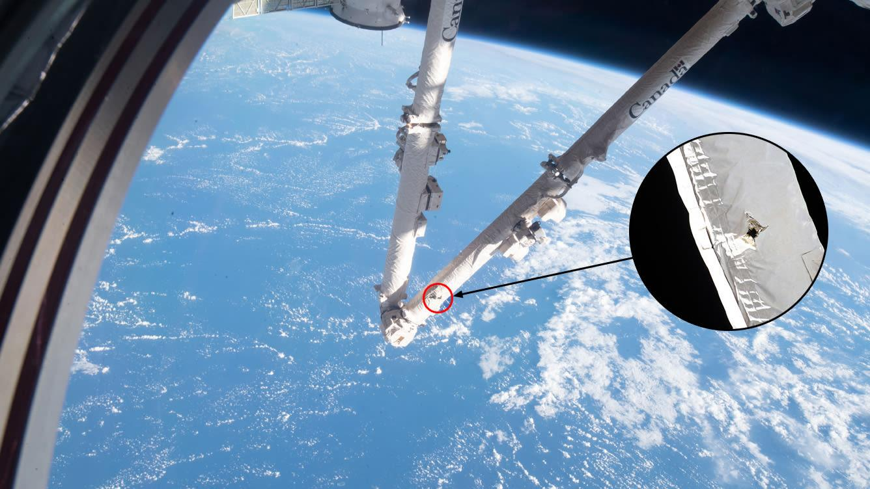
Iss canadaarm2 2021

Slide 31
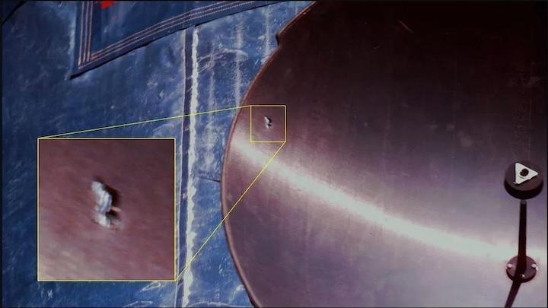
Iss radiator damage

Slide 32
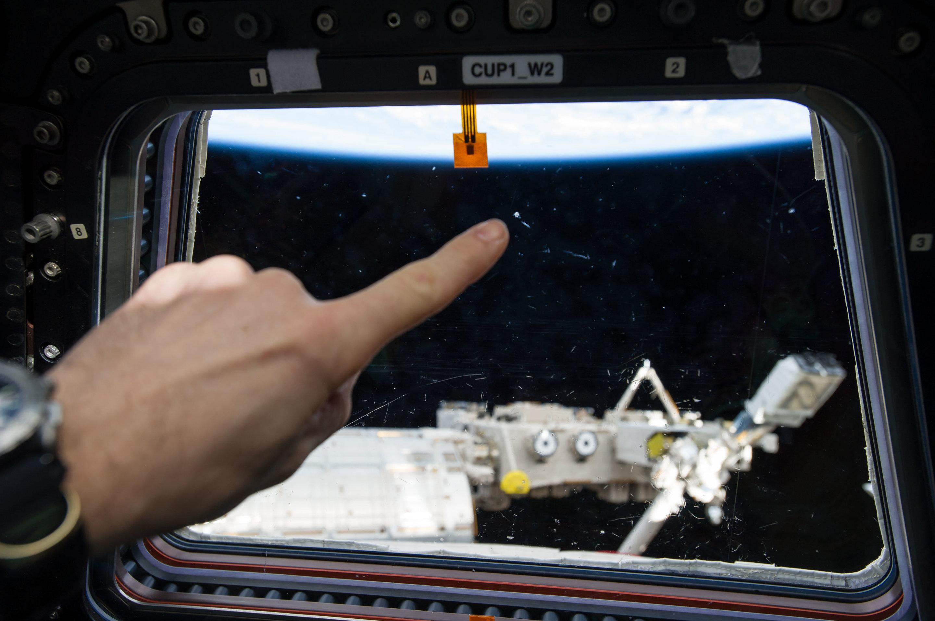
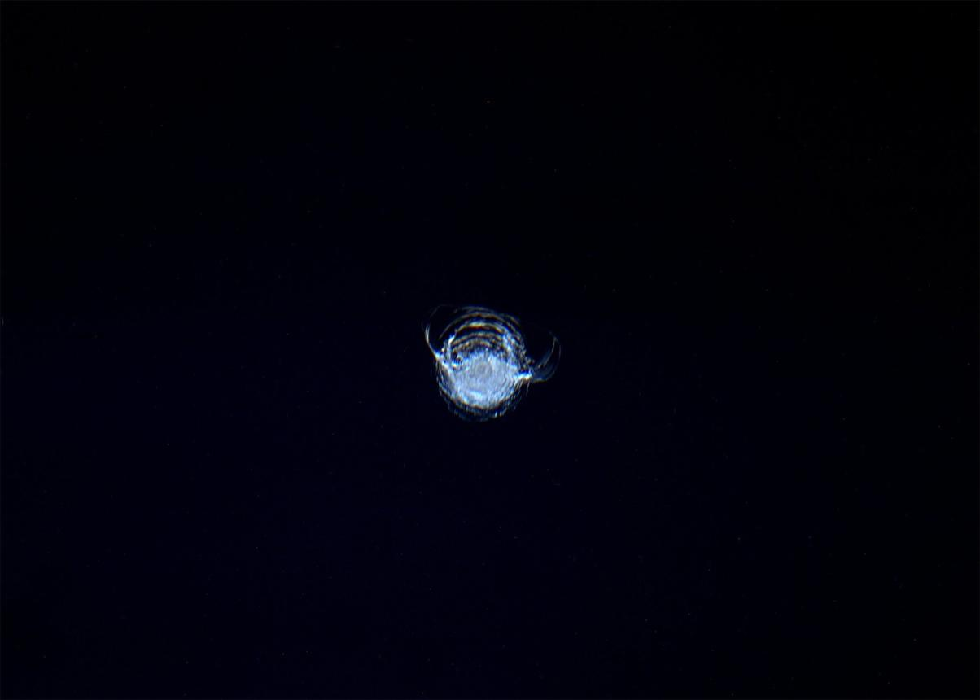
CUPOLA WINDOW IMPACT

Slide 33
SPACE DEBRIS MODELS
NASA Orbit Debris Engineering Model
ESA Meteroid and Space Debris Terrestrial Environmental Reference Model
Debris Risk Assessment and Mitigation Analysis (DRAMA) Model
NASA Orbit Debris Evolutional Model
Debris Environment Long-term Analysis Model
NASA Standard Satellite Breakup Model

Slide 34
Homework problem 4
4. Research an orbital debris modelling program, either mentioned in class or find another from a reliable source. Describe who publishes and maintains it, its main features, and how it works. Summarize its predicted effects of space debris on the ISS.

Slide 35
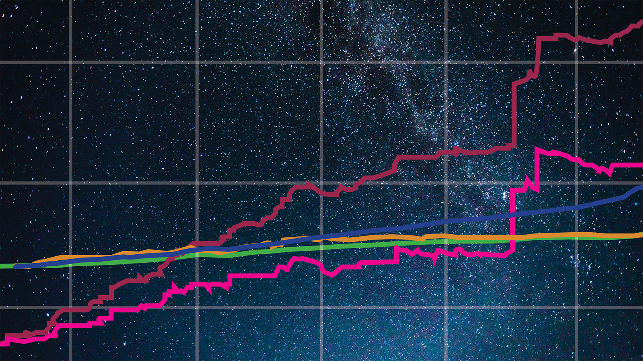
CONLCUSIONS AND QUESTIONS

Slide 36
REFERENCES
About space debris. ESA. (n.d.). Retrieved July 18, 2022, from https://www.esa.int/Space_Safety/Space_Debris/About_space_debris#:~:text=Debris%20objects%20in%20orbit%20include%20spent%20upper%20stages,in-orbit%20fragmentation%20events%20have%20been%20recorded%20since%201961.
European Space Agency, ESA Space Environment Report 2025, ESA Space Safety Programme, Apr. 1, 2025. Available: https://www.esa.int/Space_Safety/Space_Debris/ESA_Space_Environment_Report_2025. (ref slide 25)
Garcia, M. (2015, April 14). Space debris and human spacecraft. NASA. Retrieved July 18, 2022, from https://www.nasa.gov/mission_pages/station/news/orbital_debris.html
Nordqvist, C. (2016, May 13). Crack on International Space Station window from Flying Debris. Market Business News. Retrieved July 18, 2022, from https://marketbusinessnews.com/crack-window-international-space-station-flying-debris/134628/

